Slide 1

INTRO

Slide 2
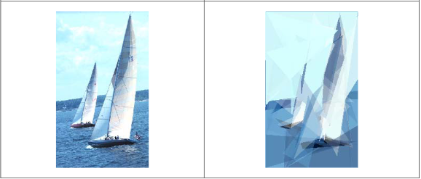
Generation of Vector-Based Graphics from Existing Bitmap Images by means of the Genetic Algorithm^{[1]}
Mateusz Guściora

Slide 3

Agenda
Content:
Scope of article, author’s goals, obtained effects
Bitmap vs Vector – based Image
Genetic Algorithm ( theory)
Genetic Algorithm used in this article
Results, Conclusions, Future Work
References
My objective:
Learn and present gained knowladge, used method, effects and results

Slide 4
Bitmap and Vector Image, Image’s generation, Genetic algorithm
Represent image in Vector – Based graphic by generating it from Bitmap image, using GA for smaller size and clean scalling
Generated Images that resamble +- original image and analysis of the results
Scope
Author’s Goals
ABOUT article
Effects

Slide 5
MIDDLE

Slide 6


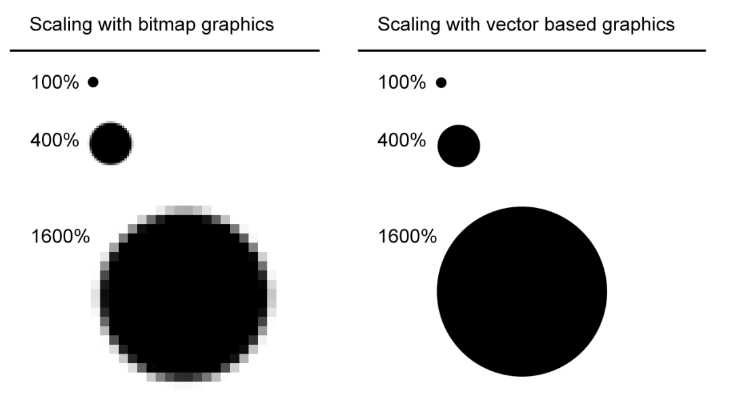
Bitmap vs Vector Image
Raster, collection of bits or pixels
Larger file size
More visualy apealing
JPG, PNG
Mathematical formulas that define shapes, colors, and placement
Smaller file size
More file conserving
E.g Logo, signs, mobile-based applications…
SVG, WMF, PDF
Fig 1. Bitmap vs vector-based graphic scaling comparision
Source: [1]

Slide 7

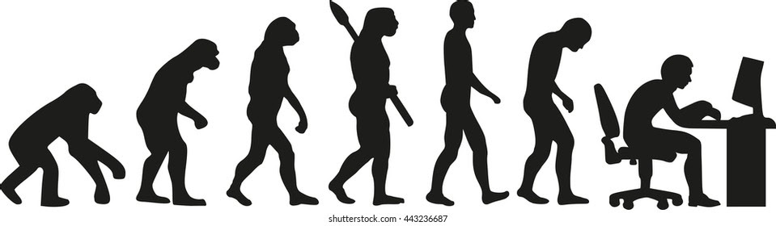
Evolutionary algorithms – little theory
Evolutionary algorithm (EA) is a metaheuristic optimization algorithm. The idea is based/inspired on a biological evolution (reproduction, mutation, recombination and selection)
Genetic algorithm (GA)
Genetic programming
Evolutionary programming
Evolution strategy
Differential evolution
Neuroevolution
Learning classifier system ^{[3]}
Types:

Slide 8
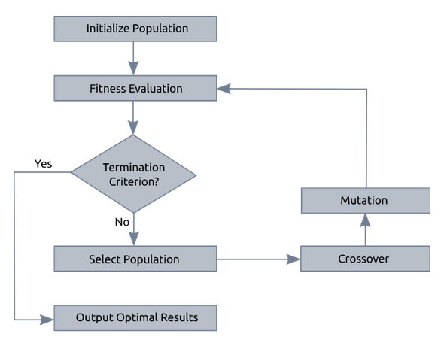
Genetic Algorithm (GA) – little theory
Initial population
Chromosome (also Genotype)
Fitness function
Genetic operators: selection, crossover, mutation
Generations and End evolution
Fig 2. Basic structure of genetic algorithm
Source: [4]

Slide 9
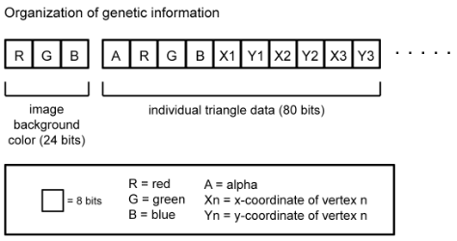
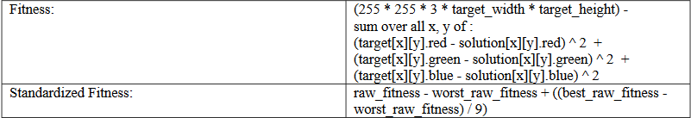
Genetic algorithm in articlE
Initial population - each byte randomized (0-255) from genetic information
Each triangle contains bytes desribing shading (r,g,b and alpha) and position (x1,y1…)
Fitness calculation and Fitness scalling
Fig 4. Organization of genetic data
Source: [1]
Fig 5. Fitness Function
Source: [1]

Slide 10
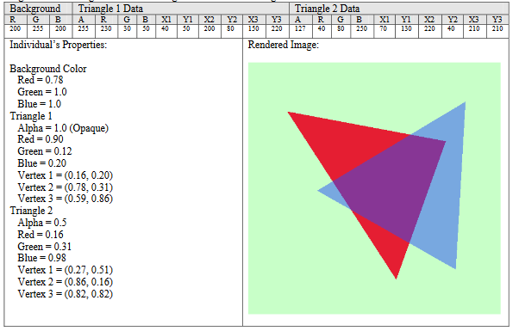
Genetic algorithm in articlE – renderingof an indivudual genetic data
Fig 6. Rendering of an individual’s genetic data into an image
Source: [1]

Slide 11
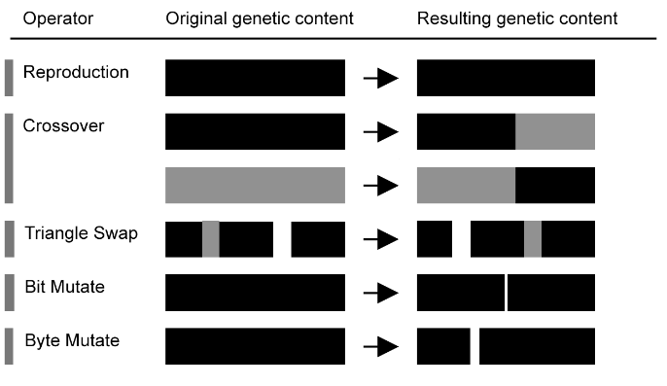
Genetic algorithm in articlE – genetic operators
Fig 7. Used Genetic operators
Source: [1]

Slide 12
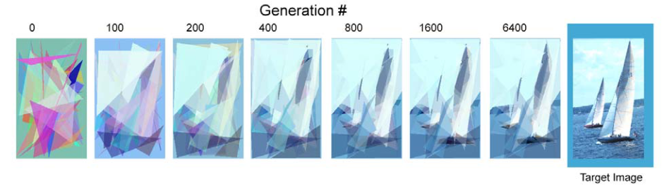
Example of the Generation process
Fig 8. Example of evolution of a vector based image
Source: [1]

Slide 13
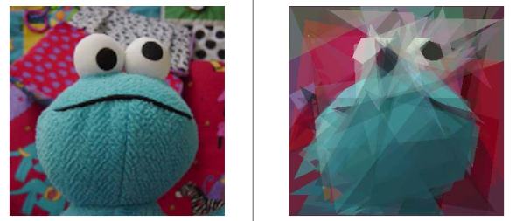
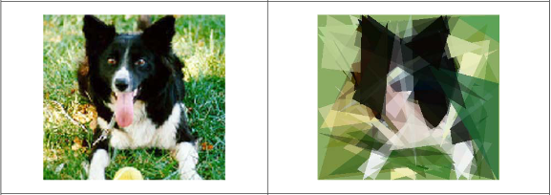
Results
Fig 9. Example of result a
Source: [1]
Fig 10. Example of result b
Source: [1]

Slide 14

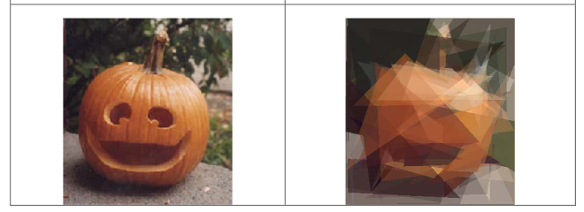
Results
Fig 11. Example of result c
Source: [1]
Fig 12. Example of result d
Source: [1]
Fig 13. Example of result e
Source: [1]

Slide 15
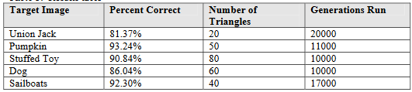
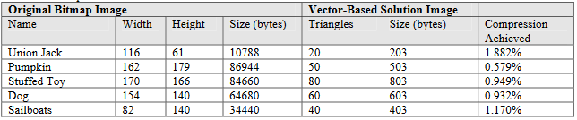
Results
“Percent correct” linear metric of how close to perfect each solution was
Quantitative or Qualitative?
Compression’s comparison:
Vector based solution = 3 + (10*T)
Bitmap image = 3* width* heght
Fig 14. Results table
Source: [1]
Fig 15. Compression results
Source: [1]

Slide 16
GA is viable method for generating vector-based graphics from existing bitmap images
Quality of results can most likely be improved by changing parametres
+ Easy to implement and effective but – run time and computational resources used
Qualitative over Quantitative
CONCLUSIONS*

Slide 17
Future work – possible direction*
Try to improve the method by implementing variable lenght that could inceare or decrease the numer of triangles
Increase the power of rendering engine (additional shapes and forms)
Vector – based video where geometric primitives are viewed in 3 dimnesions

Slide 18
OUTRO

Slide 19
References
[1] Weller, C. (2009). Generation of Vector-Based Graphics from Existing Bitmap Images by Means of the Genetic Algorithm
[2]https://xd.adobe.com/ideas/principles/app-design/bitmap-vs-vector-images-difference/ [date: 15.11.2021]
[3]https://en.wikipedia.org/wiki/Evolutionary_algorithm [date: 15.11.2021]
[4]https://skill-lync.com/student-projects/week-4-genetic-algorithm-316 [date: 15.11.2021]
[5]https://www.mathworks.com/help/gads/how-the-genetic-algorithm-works.html [date: 15.11.2021]

Slide 20
THANK YOU
? questions
? questions

